Slide 1


2022
Software solution for student houses
Project made by : Andrei,Radu & Bogdan

Slide 2
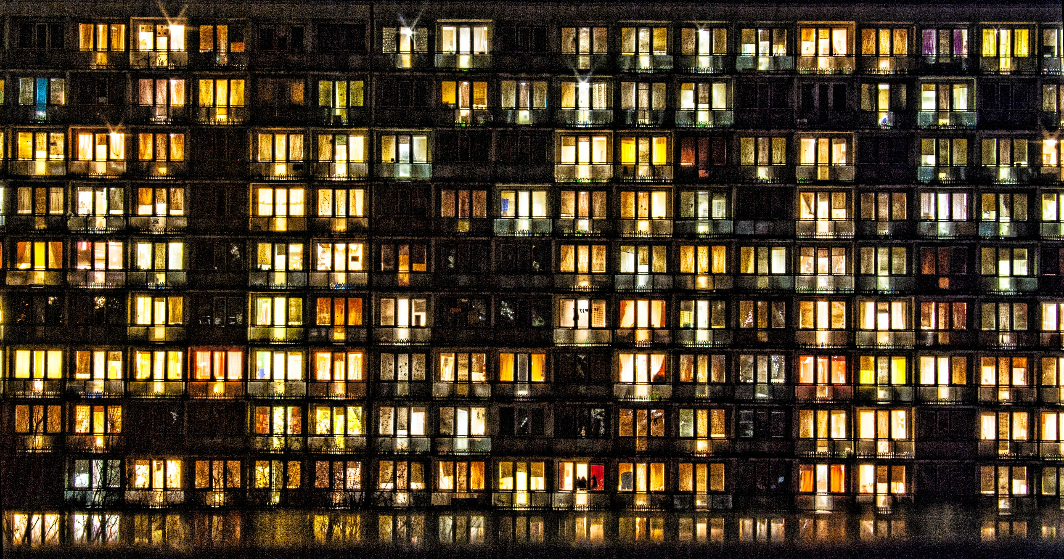
BackStory

Slide 3
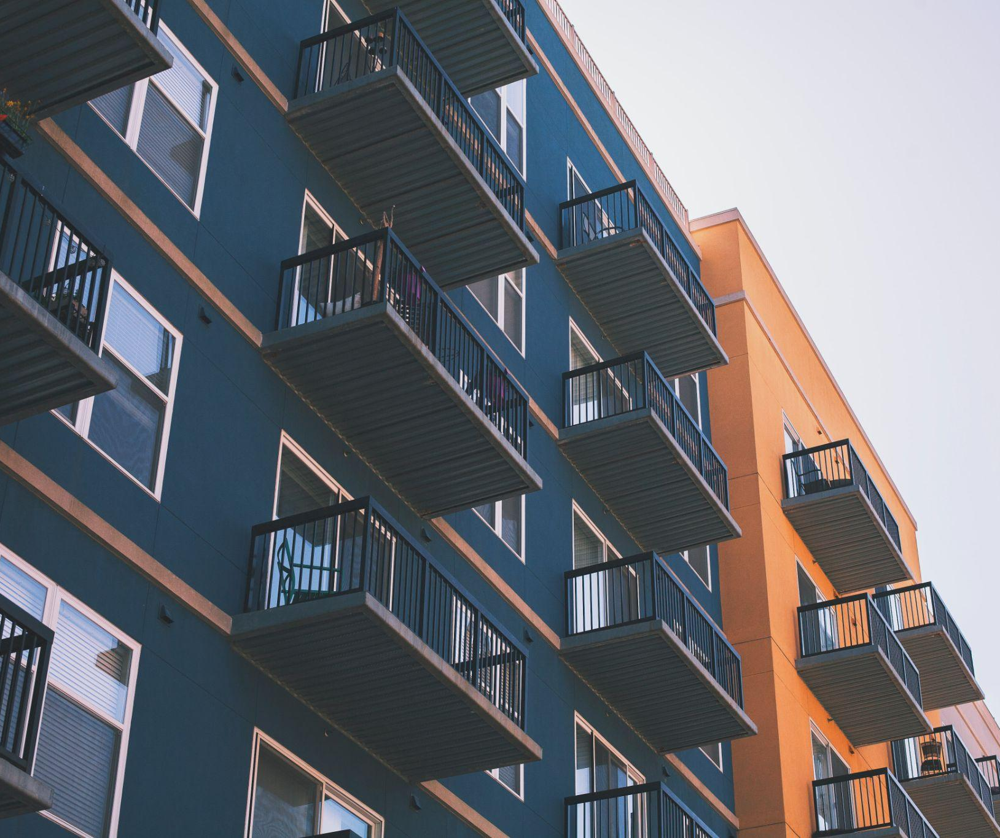
Introduction
A windows form application divided in two parts
Admin/Student accounts
Software solution

Slide 4
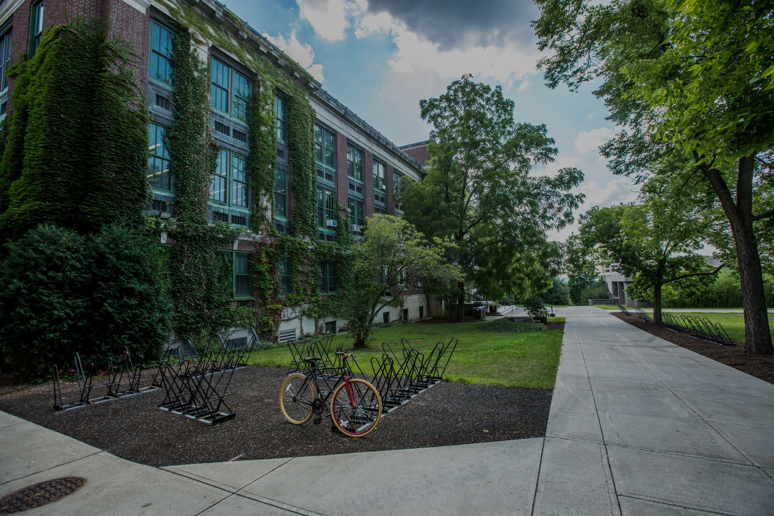
App functionalities For students

Slide 5

App functionalities
For Admin

Slide 6




Reflection
Working in a group
Learning new concepts (OOP)
Coding & Debugging

Slide 7


Slide 8


